Slide 1
THE GEORGE WASHINGTON UNIVERSITY
School of Engineering and Applied Science
Department of Computer Science
Final Review
for the
Voice Launch
By
Amir Raminfar
CSci 196-11
Senior Computer Science Design Project
Sunday, November 8, 2026

Slide 2
System Requirements
Hardware:
  Microphone
  Speakers (Not required but recommended)
  At least 800 MHz Processor
  At least 256 MB RAM
  Keyboard and Mouse
  Enough disk space to save the WAV files
Software:
  Windows XP or later
  Java Virtual Machine 1.5 or later

Slide 3
Theory
Algorithm for Dynamic Time Warping
M(i,j) = |sample_feature(i) - template_feature(j)| FOR i=1 to i<size(M) M(i,0) += M(i-1,0) M(0,i) += M(0,i-1) End FOR FOR i = 1 to i < size(M) FOR j = i to j < size(M) min = MIN (M[i][j - 1], M[i - 1][j], M[i - 1][j - 1])); M(i,j) += min; End FOR IF i + 1 < size(M) FOR j = i + 1 to j < size(M) min = MIN (M[j][i - 1], M[j - 1][i], M[j - 1][i - 1]); M(j,i) += min; End FOR End IF End FOR

Slide 4
Theory
S1 and S2 have the following features: {1, 6, 9, 6, 5} and {2, 6, 8, 9, 8} respectably.
7 | 2 | 1 | 2 | 3
8 | 3 | 0 | 3 | 4
7 | 2 | 1 | 2 | 3
5 | 0 | 3 | 0 | 1
1 | 4 | 7 | 4 | 3
End of the matrix
Compute the matrix, by doing
M(i,j) = |sample_feature(i) – template_feature(j)|
Beginning of the matrix
Figure 2 - Example Matrix for DTW
28 | 8 | 3 | 4 | 7
21 | 6 | 2 | 5 | 8
13 | 3 | 2 | 4 | 7
6 | 1 | 4 | 4 | 5
1 | 5 | 12 | 16 | 19
Final Distance Value
Step through the matrix, until the end
Of the matrix is reached. The value at
The top-right represents the final
Distance vector.
Figure 4 - Resulting Matrix for DTW

Slide 5
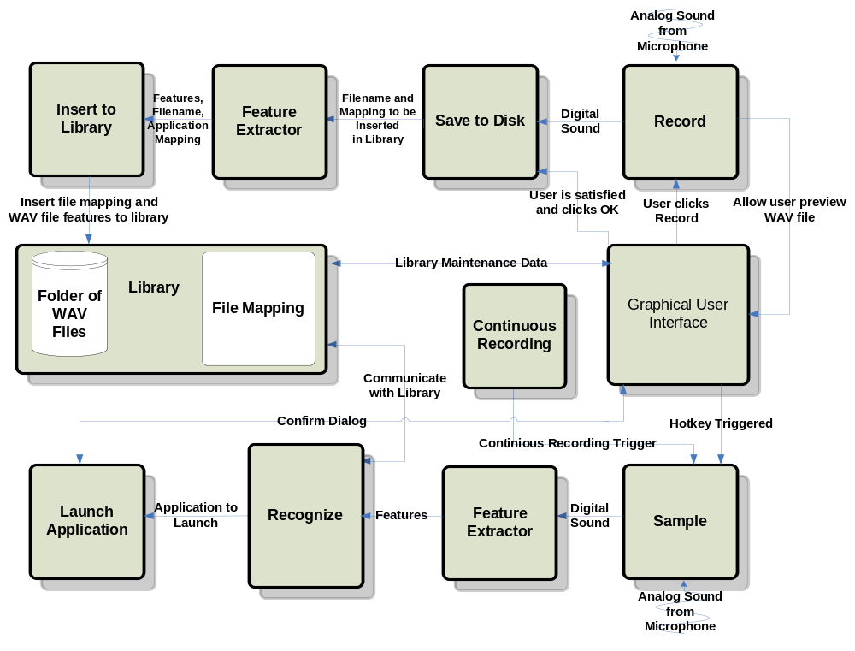
BLOCK DIAGRAM

Slide 6
Record Module
Parameters: IN (Nothing) OUT (AudioInputStream: audioInputStream) Initialize AudioLine Create AudioFormat If Line Does Not Supports format then return with error Open line Start recording on line While (Time in Microseconds /1000/1000) < 2 Read data from line into a temporary buffer Place the temporary buffer into a OutputStream End while Stop and close line Flush and close Convert ByteArrayOutputStream to ByteArrayInputStream Convert ByteArrayInputStream to AudioInputStream Return AudioInputStream to GUI so that user can preview

Slide 7
Save to Disk Module
Parameters: IN (AudioInputStream: audioInputStream, Application Filename: filename) OUT (WAV file, Application Filename: filename) Check to see audioInputStream is not null Reset to beginning of Stream Parse the name of the application Create a new file with the same name of application Write audioInputStream with filename If Write returns -1 then throw exception Insert to library with new created WAV file and application mapping

Slide 8
Insert to Library Module
Parameters: IN (Sample Features: samplefeatures, Application Filename: filename) OUT (Nothing) Open sample file Open database file Append 100 features to database file and application that it is mapped to Close file Update GUI if needed

Slide 9
Sample Module
Parameters: IN (Nothing) OUT (AudioInputStream: audioInputStream) Initialize AudioLine Create AudioFormat If Line Does Not Supports format then return with error Open line Start recording on line While (Time in Microseconds /1000/1000) < 2 Read data from line into a temporary buffer Place the temporary buffer into a OutputStream End while Stop and close line Flush and close Convert ByteArrayOutputStream to ByteArrayInputStream Convert ByteArrayInputStream to AudioInputStream Call recognize module with AudioInputStream as a parameter

Slide 10
Recognize Module
Parameters: IN (Recorded Sample: sample) OUT (String: Best matched application) Extract features from sample Get all templates from library For every template M(i,j) = |sample_feature(i) – template_feature(j)| FOR i=1 to i<size(M) M(i,0) += M(i-1,0) M(0,i) += M(0,i-1) End FOR FOR i = 1 to i < size(M) FOR j = i to j < size(M) min = MIN (M[i][j - 1], M[i - 1][j], M[i - 1][j - 1])); matrix[i][j] += min; End FOR IF i + 1 < size(M) FOR j = i + 1 to j < size(M) min = MIN (M[j][i - 1], M[j - 1][i], M[j - 1][i - 1]); matrix[j][i] += min; End FOR End IF End FOR End for Find the template with the least cost Confirm that this is the correct Application If it is not the correct application temporarily remove this item If this is the third time then return nothing Else Goto Line 2 and repeat the recognition process Get which application correlates to the least cost template Return the application address as a string

Slide 11
Launch Application Module
Parameters: IN (Application address: filename) OUT (Nothing) Check if filename exists If filename does not exist then show warning and return Get runtime class Execute filename

Slide 12
Feature Extractor Module
Parameters: IN (WAV File) OUT (Feature Array) Divide sample into 100 intervals For every interval Compute number of zero-crossings by looking at two values at once End for

Slide 13
Continuous Recording Module
Parameters: IN (Nothing) OUT (Nothing) Start recording from microphone Write data from microphone to a buffer Convert the buffer to bytes Append the bytes to a circular array Flatten the circular array and try to compare it with features saved for the word ‘computer’ If the minimum distance length is less than a certain value Then spawn a new thread for recognizing a new thread and clear circular array Else Do nothing

Slide 14
Library
Parameters: IN (Nothing) OUT (Templates) Open database file For every template Read template features and application mappings Save each template into an array of 100 features End for Close database files Return a matrix of size m by n where n is size of features and m is number of templates

Slide 15
Module List
Module Name | Called By | It Calls | Lines Est. | Lines Coded | Hours Coded | $ to Code
RECORD | GUI | GUI | 500 | 150 | 3 | $ 120
SAVE TO DISK | Library | - | 600 | 50 | 1 | $ 40
INSERT TO LIBRARY | Library | - | 1,000 | 200 | 4 | $ 160
SAMPLE | GUI | Recognize | 500 | 150 | 2 | $ 80
RECOGNIZE | Sample | Launch Application | 1,500 | 490 | 11 | $ 440
LAUNCH APPLICATION | Recognize | - | 100 | 50 | 1 | $ 40
FEATURE EXTRACTOR | Library/Recognize | - | 1,000 | 200 | 5 | $ 200
LIBRARY | - | - | 300 | 300 | 4 | $ 160
GUI | User | - | 1,600 | 1,700 | 34 | $ 1,360
TOTAL |  |  | 7,100 | 3,290 | 65 | $2,600

Slide 16
History
Added System Tray
Added Confirmation Box
Added ‘Cancel’ to confirmation box
Added Continuous Recording
Added Microphone Monitor
Allocated more time for the GUI

Slide 17
Tests to Verify the Design
Module Name | Input | Expected Result | Status
Record | Analog Sound | To be digitized and played successfully after recording. | Pass
Record | Analog Sound | Test with a quiet room. | Pass
Record | Analog Sound | Record with microphone. | Pass
Record | Analog Sound | Record with other sources besides a microphone. | Pass
Save to File | Sound from Record module | Digital sound to be saved on disk and played through a third-party WAV player. | Pass
Feature Extractor | WAV file | Successfully divided into 100 uniform intervals. | Pass
Feature Extractor | WAV file | The correct number of zero-crossings for 500 samples should be extracted. | Pass
Feature Extractor | WAV file | The correct number of zero -crossings for all interval should be extracted successfully. | Pass
Feature Extractor | WAV file | The correct number of average time for each interval is returned. | Pass

Slide 18
Tests to Verify the Design
Module Name | Input | Expected Result | Status
Insert to Library | WAV file from save to disk module | Open and write to file successfully. | Pass
Insert to Library | WAV file from save to disk module | Extract should be successfully written to file. | Pass
Sample | Analog Sound | Digitized and played successfully after recording. | Pass
Recognize | Digital sound from sample module | Stepped through the matrix successfully. | Pass
Recognize | Digital sound from sample module | Matrix created successfully. | Pass
Recognize | Digital sound from sample module | Template with best match and within threshold is returned. | Pass
Launch Application | Application address from recognize module | Application should be launched. | Pass
Library | WAV files | All templates should be returned in a matrix. When needed it should return all WAV files to the GUI. | Pass

Slide 19
Tests to Verify the Design
Module Name | Input | Expected Result | Status
GUI | Events are triggered by user | Buttons can trigger a number of events ranging from recording to recognition. | Pass
GUI | Hotkey | Hotkey should trigger the recording to being | Pass
GUI | Events are triggered by user | Buttons can trigger a number of events ranging from recording to recognition. | Pass
Accuracy | Application name via voice x 10 time | At least 8 of the 10 tries are successful | Pass
Accuracy | The above test times done with 5 different application names | At least 8 of the 10 tries are successful for each try | Pass

Slide 20
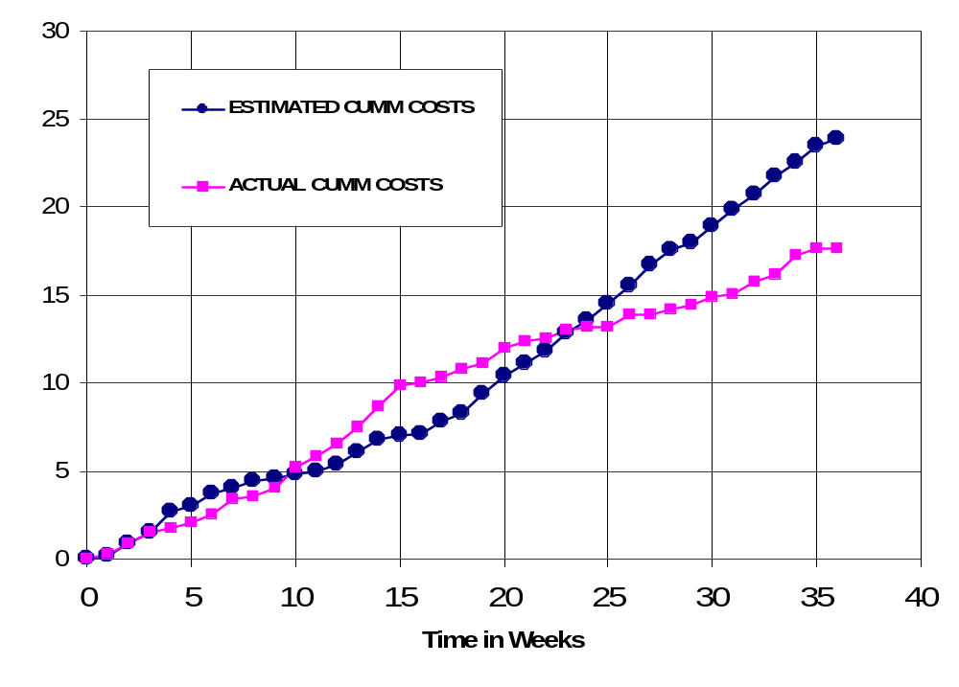
CUMULATIVE LABOR COSTS

Slide 21
ECONOMIC ANALYSIS
 | Labor Rate | Initial Est. Hours | Initial Est. Cost | Current Est. Hours | Current Est. Cost
System Analyst | $45.00 | 215 | $9,686 | 113 | $5,085
Programmer | $40.00 | 268 | $10,720 | 68 | $2,720
Test Programmer | $35.00 | 31 | $1,085 | 91 | $3,185
Technical Writer | $35.00 | 67 | $2,345 | 190 | $6,650
TOTAL |  | 581 | $23,836 | 462 | $17,640
DIRECT OVERHEAD @ 100% |  |  | $23,836 |  | $17,640
SUBTOTAL |  |  | $47,673 |  | $35,280
A&G COSTS @ 40% |  |  | $19,069 |  | $14,112
SUBTOTAL |  |  | $66,742 |  | $49,392
PROFIT @ 20% |  |  | $13,348 |  | $9,878
TOTAL COST OF PROTOTYPE |  |  | $80,090 |  | $59,270

Slide 22
UNIT COSTS SOLD
SOLD BY CORPORATION AS A RETAILER ON THE INTERNET
 | Initial Estimate | Current Estimate
PROTOTYPE COSTS | $80,090 | $59,270
INSTALL MACHINE AND SOFTWARE | $50,000 | $50,000
SUBTOTAL | $130,090 | $109,270
OVERHEARD @ 200% | $260,180 | $218,541
SUBTOTAL | $390,269 | $327,811
DOCUMENTATION | $0 | $0
PACKAGING SUBTOTAL | $0 | $0
SUBTOTAL | $390,269 | $327,811
A&G @ 40% | $156,108 | $131,124
SUBTOTAL | $546,377 | $458,936
PROFIT @ 20% | $109,275 | $91,787
SUBTOTAL | $655,653 | $550,723

Slide 23
UNIT COSTS SOLD
 |  | Initial Estimate |  | Current Estimate
 | # of copies | Price/Copy | Total Profit | Price/Copy | Total Profit
Total to Sell | 1,000,000
Recoup Prototype Costs | 100,000 | $6.56 | $109,275 | $5.51 | $91,787
Excess Profit from Recoup | 100,000 | $12.04 | $1,204,347 | $13.09 | $1,309,277
Remainder to Sell | 900,000 | $18.60 | $16,740,000 | $18.60 | $16,740,000
 |  | Minus 40% for A&G | $6,696,000 | Minus 40% for A&G | $6,696,000
Subtotal |  |  | $10,044,000 |  | $10,044,000
Total Profit |  |  | $11,357,623 |  | $11,445,064

Slide 24
Conclusion
Overall the project was a success
Should have allocated more time for creating the GUI and less time for the Recognition Module

Slide 25
Demo
Installation File
Creating new applications
Launch new applications

